Slide 1
DealFinder
Class and ER Diagram
Group 2 (A1)
Presented By:
Ramisa Alam : 1705004
Md. Zarif Ul Alam : 1705010

Slide 2
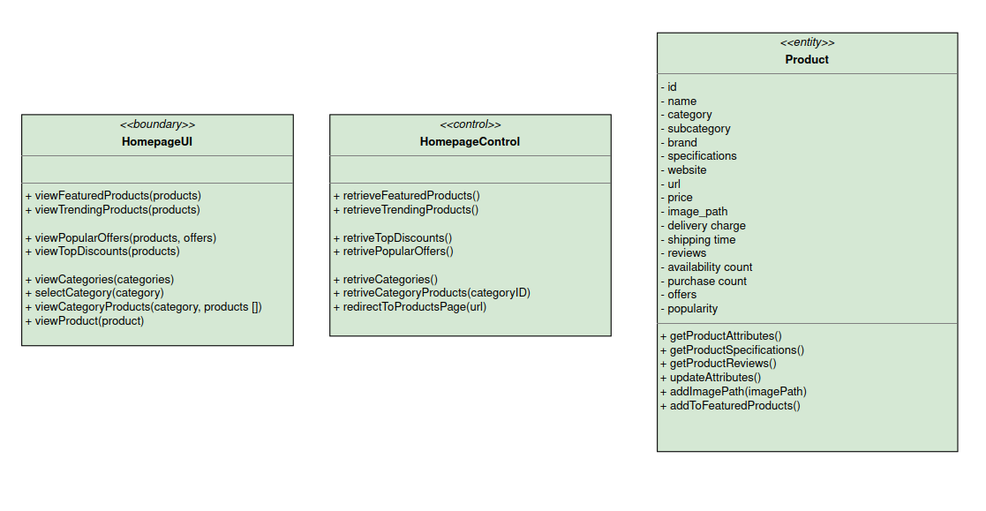
Homepage

Slide 3
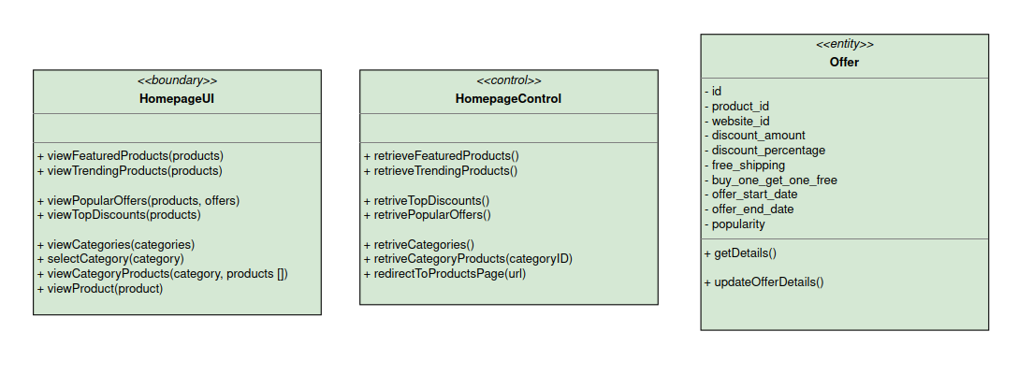
Homepage

Slide 4
Homepage

Slide 5
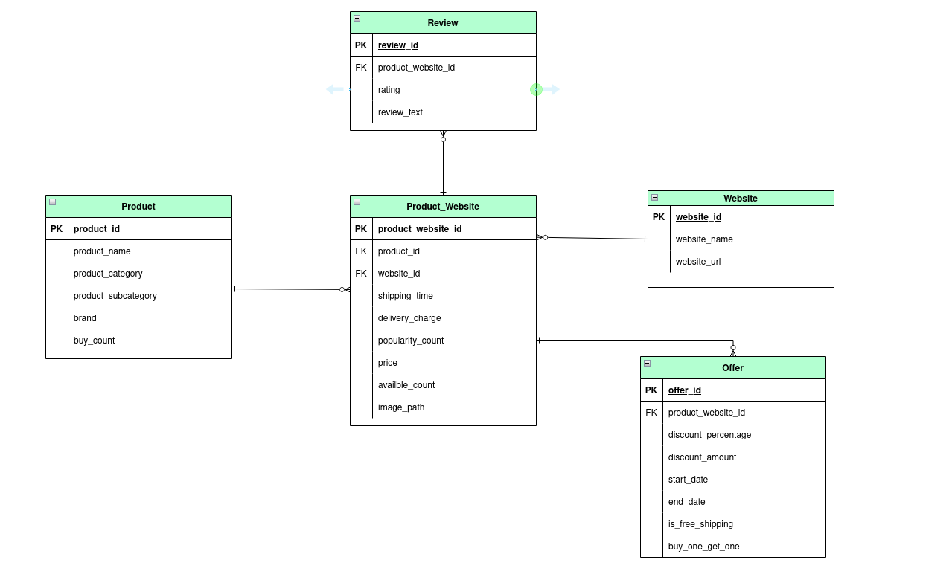
ERD Related to Homepage

Slide 6
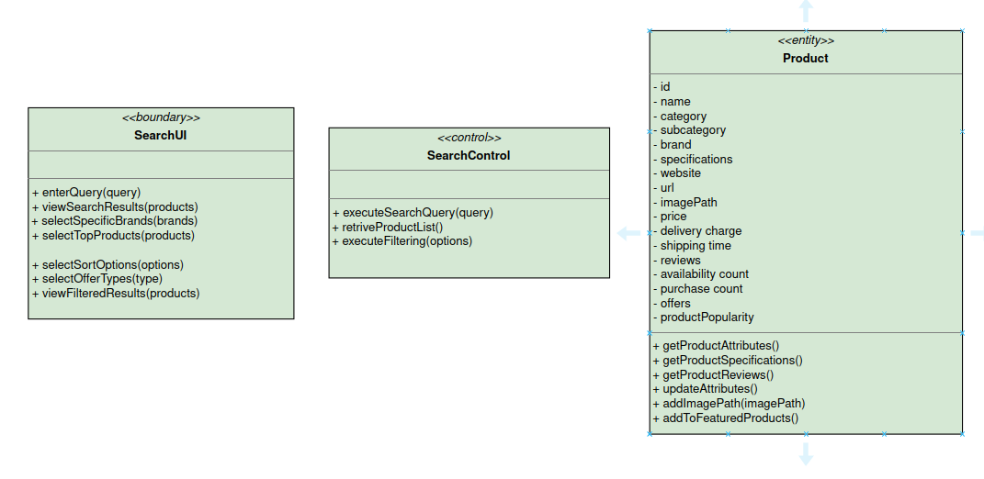
Search and Filter : Searching

Slide 7
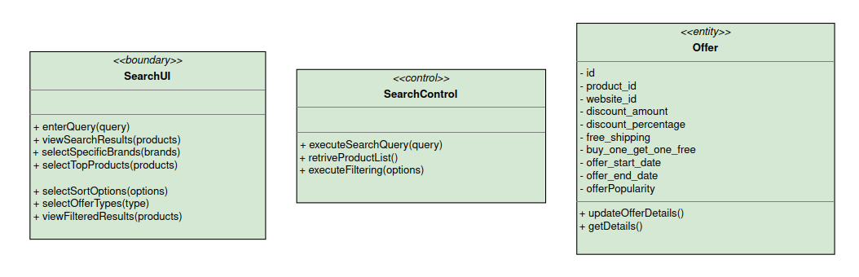
Search and Filter : Filtering

Slide 8
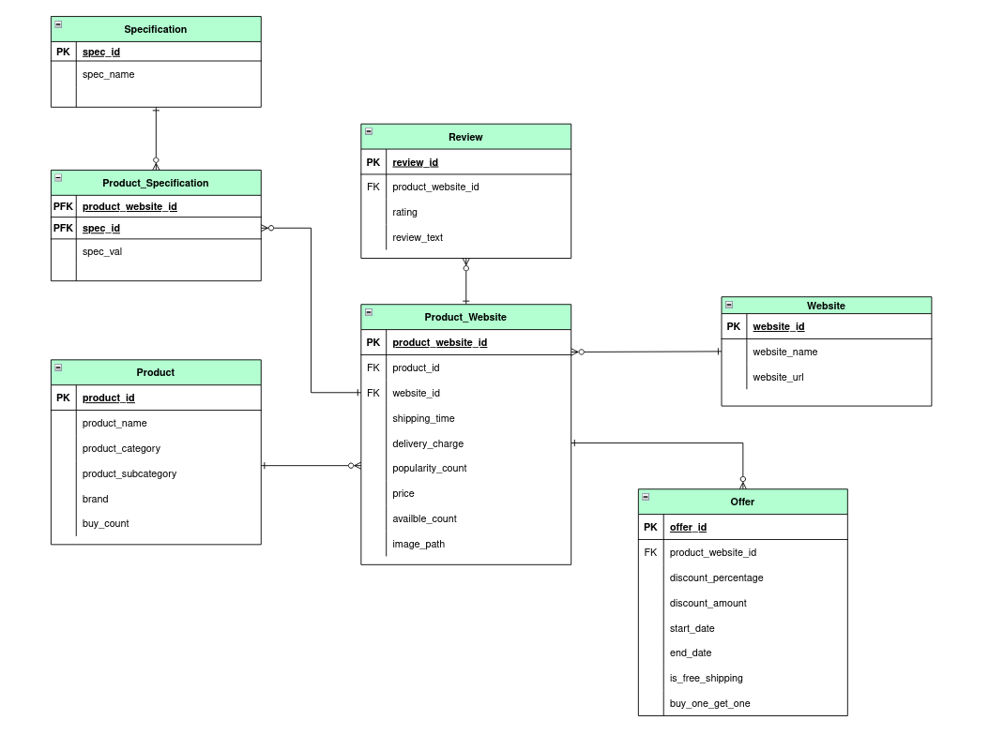
ERD Related to Search and Filter

Slide 9
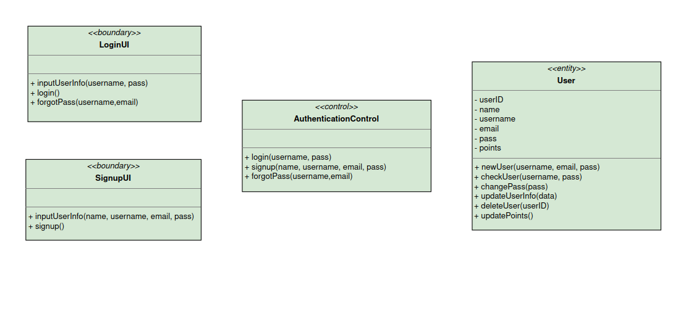
User : Authentication

Slide 10
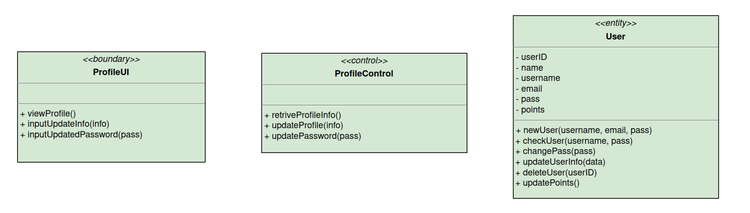
User : Profile

Slide 11
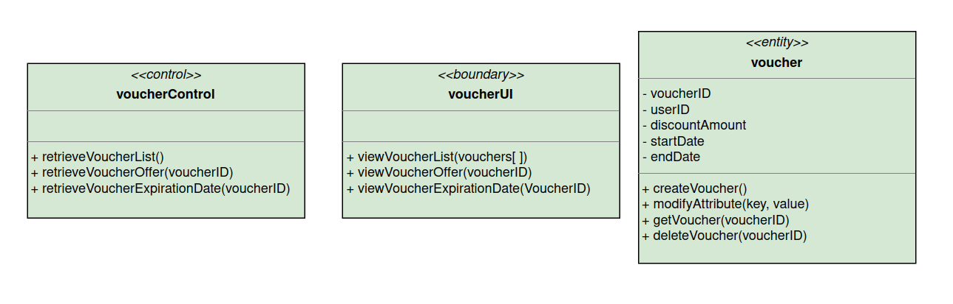
User : Vouchers
-websiteid

Slide 12
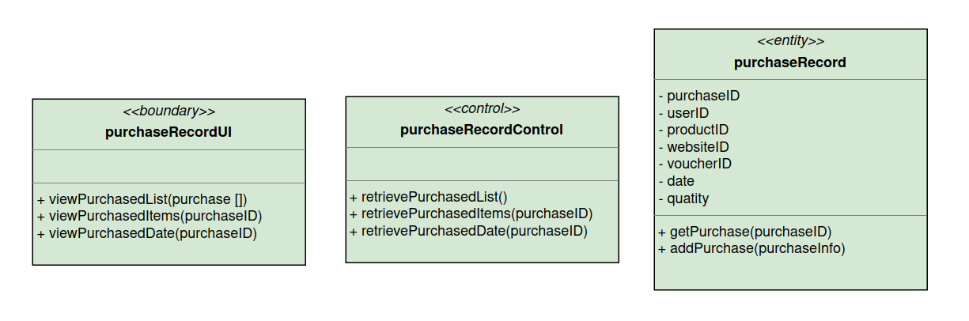
User : Purchase History

Slide 13
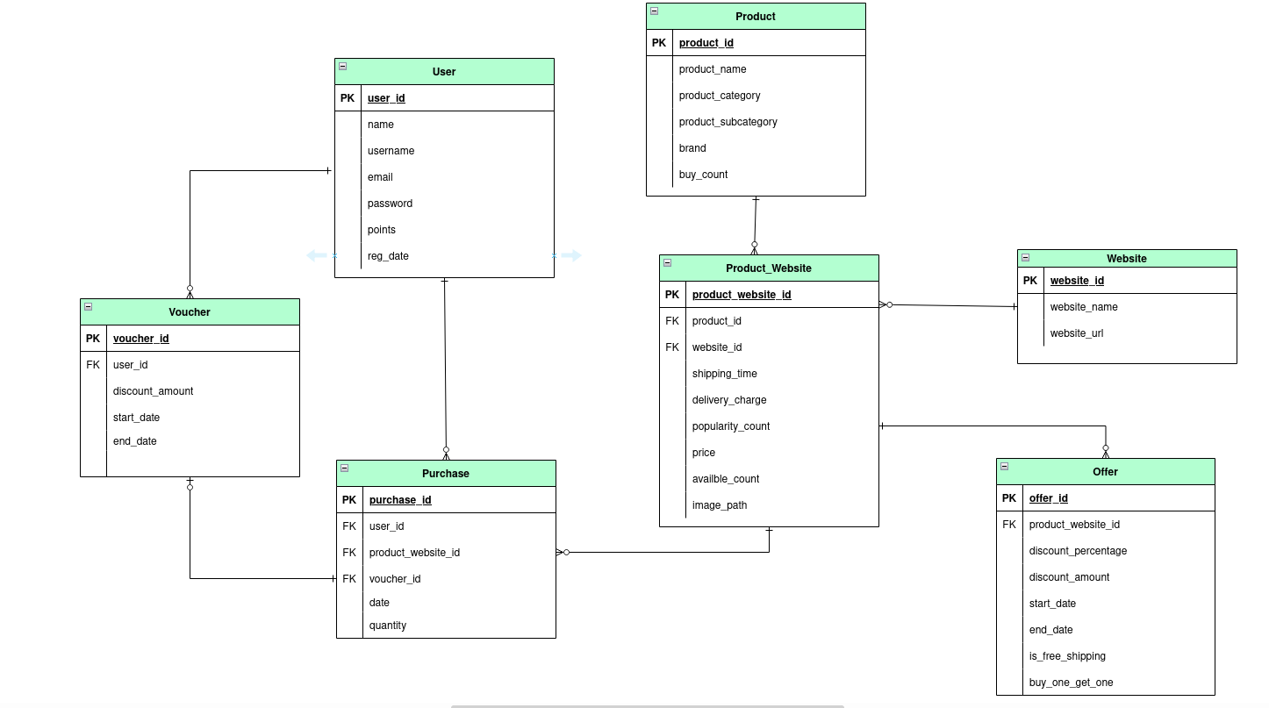
ERD Related to User Operations

Slide 14
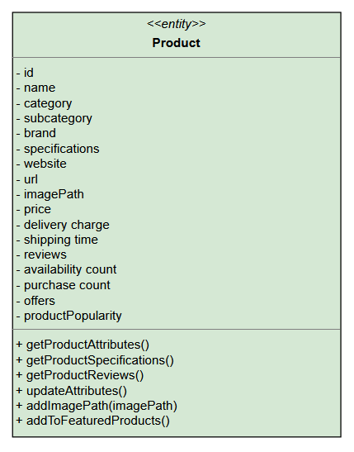
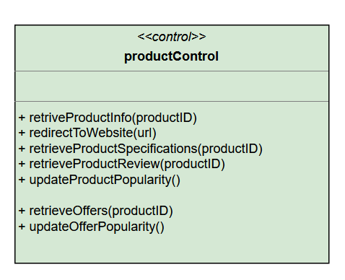
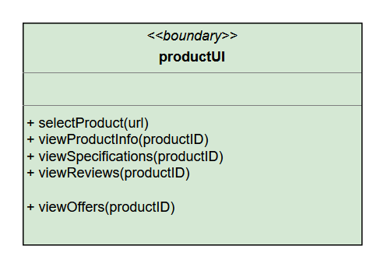
Viewing a Product

Slide 15
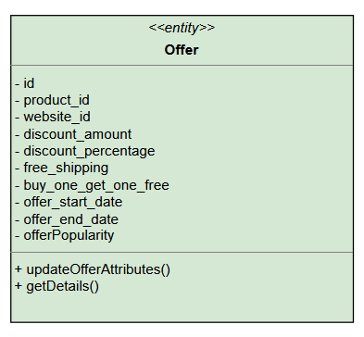
Viewing a Product

Slide 16
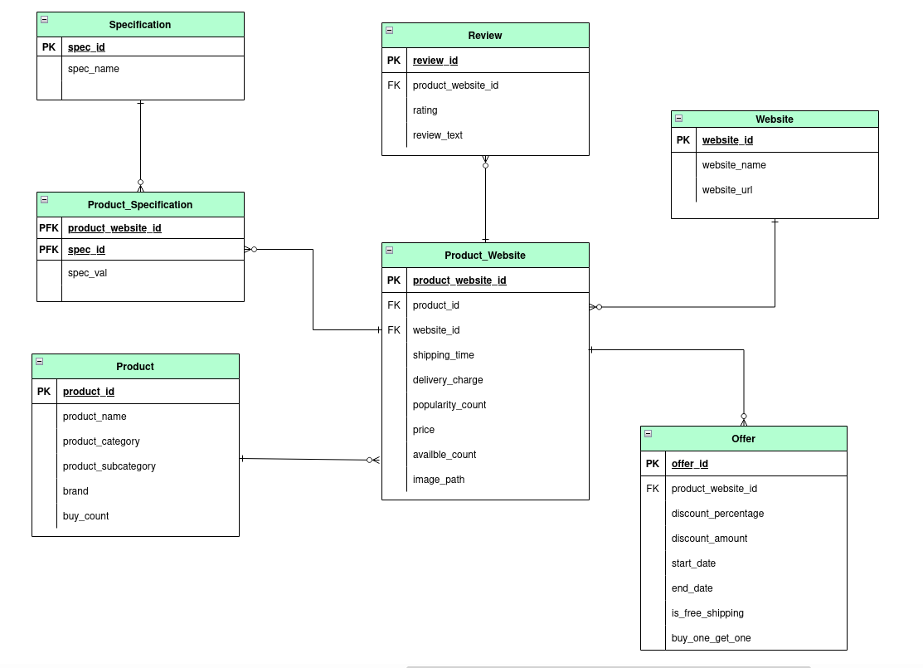
ERD Related to Product Viewing

Slide 17
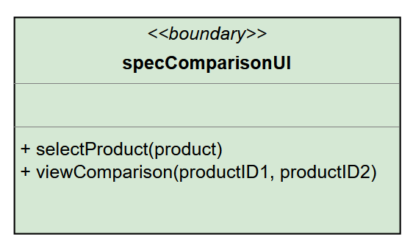
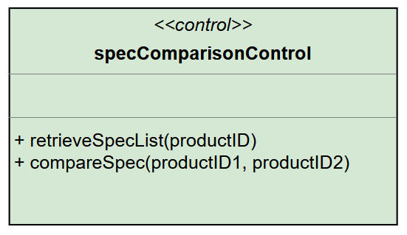
Comparison : Single Product

Slide 18
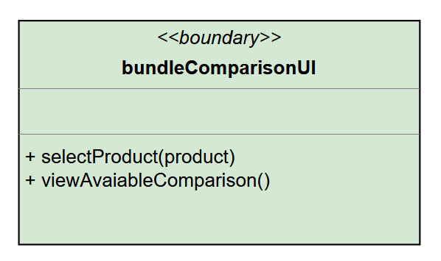
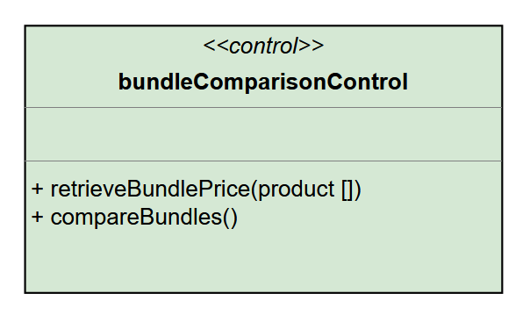
Comparison : Bundle

Slide 19
ERD Related to Comparison

Slide 20
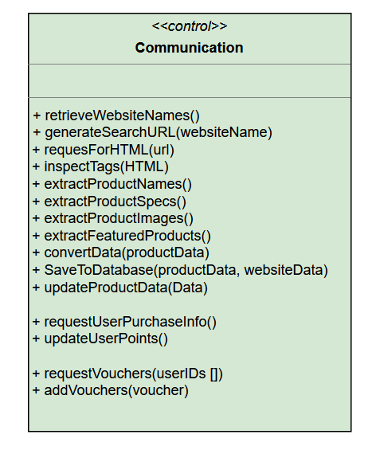
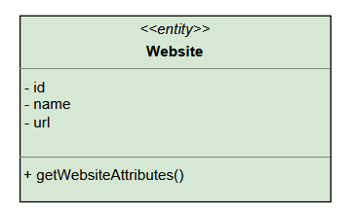
Communicate

Slide 21
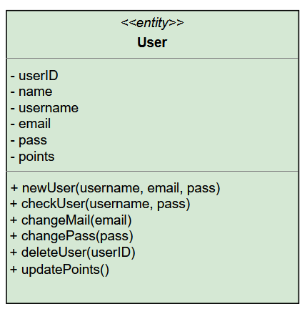
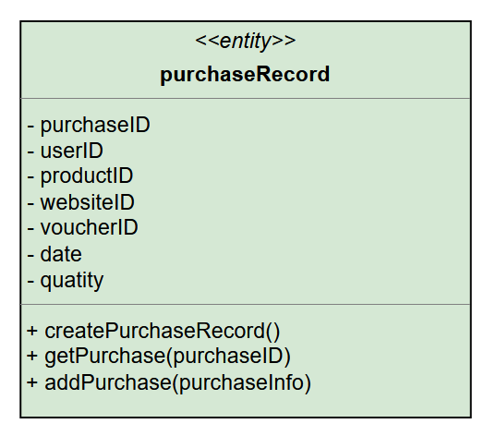
Communicate

Slide 22
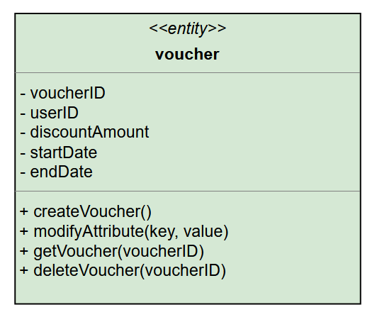
Communicate
-websiteid

Slide 23
THANK YOU

